Slide 1

Maximizing Sales and Optimizing Services of a Financial cum Service Based Firm
A BDM Capstone Project by
(Name: Debjit Mondal | Roll No: 23f2004618)
IITM BS Degree Program
A BDM Capstone Project
Notes:
Good evening, I’m Debjit Mondal, and today I will be presenting my capstone project conducted at Unique Enterprise, focusing on optimizing mutual fund sales and client portfolio alignment using data-driven methodologies.

Slide 2
Organizational Background
Unique Enterprise
Type and Services offered: B2C financial and service based firm offered Mutual fund sales, insurance, ITR filing, money transfer, ticket bookings
Current No of Clients: 160+
Main source of revenue: Commission from mutual funds sales
Challenges: Inconsistent mutual fund AUM (Assets Under Management) growth and portfolio misalignment
A BDM Capstone Project
IITM BS Degree Program
Notes:
Unique Enterprise is a financial and service-based B2C firm, offering mutual funds, insurance, ITR filing, money transfers, and ticket bookings.
It serves over 160 clients.
The main source of revenue of the business is from commission earned from mutual funds sales
Challenges that the business faces are inconsistent growth in mutual fund AUM and portfolio misalignment.

Slide 3
Problems
Challenges in Maximizing Profit from Mutual Fund Sales
Difficulties in Aligning Client Portfolios with Risk Profiles
Ad-hoc, unstructured sales approach limits AUM growth.
Lack of data-driven strategy leads to missed profit opportunities.
No systematic process to assess client risk tolerance & goals.
Competing digital platforms offer advanced, personalized investment advice.
A BDM Capstone Project
IITM BS Degree Program
Notes:
The business is facing two core issues:
First, the business is struggling to maximize profit from its mutual fund segment as the mutual fund sales strategy is ad-hoc and lacks structure, resulting in limited asset growth and missed profit opportunities.
Second, there is no systematic process to assess each client's risk tolerance and investment goals, causing portfolios to misalign with true client needs.
At present Digital competitors are gaining ground by providing more advanced and personalized investment advice challenging offline business like Unique Enterprise

Slide 4
Data Collection
Data collection
Primary Data Collection
Mutual funds transaction records
Quarterwise NAV data
Historical return of mutual funds
Via Survey (through Unique Enterprise)
Risk assessment form
Printed copies
Google form
A BDM Capstone Project
IITM BS Degree Program
Notes:
I had collected mutual fund transaction records, NAV data each quarter, and mutual fund returns history from the business.
A risk assessment form containing different relevant questions had been prepared with consulting the owner of the business to gather information of the risk taking capacity of the clients.

Slide 5
Analysis Methodology
Analysis
New Investment, redemption and AUM trend
Categorizing mutual funds into different risk categories
Risk assessment of clients
Finding current risk exposure of present portfolio of existing clients
Fund performance ranking
Tools
Spreadsheet
Google Colab
Libraries - Numpy, Pandas, Scikit-learn
A BDM Capstone Project
IITM BS Degree Program
Notes:
I had analyzed new investments, redemptions, and overall AUM trends.
Categorized funds into different risk levels
Assessed client risk capacity,
Checked if actual portfolios matched these risk categories.
Listed top 10 performing funds of different time-frames.
Tools that I had used are spreadsheets to find the investment trend, calculation of risk score and google colab with Python libraries like Numpy, Pandas, and Scikit-learn to categorize mutual funds into different risk level.

Slide 6
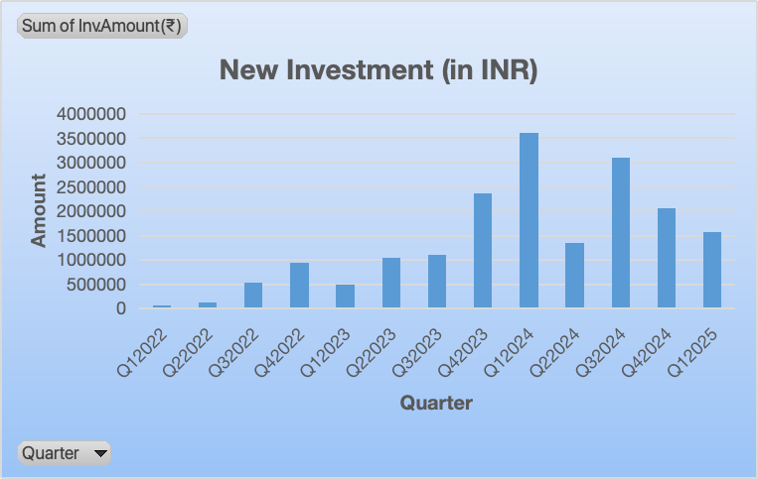
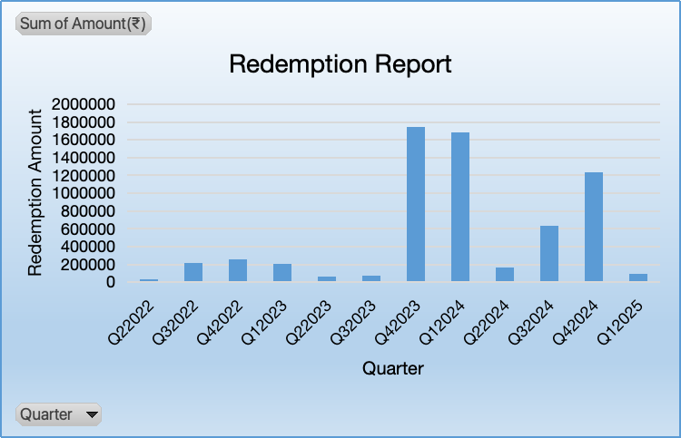
Finding - New Investment, Redemption and AUM trend
New Investment trend finding
Spike during Q1-2024 and Q3-2024.
The business had organised targeted campaign in a corporate function and training college during that period.
Redemption trend finding
Surge during Q3-2023 and Q1-2024
Two high value investor had redeemed substantial amount during that period
A BDM Capstone Project
IITM BS Degree Program
Notes:
After the analysis it is found that
There were notable spikes in new investments during Q1-2024 and Q3-2024, after enquiring to the owner it is found that the business had organised campaign at a corporate event and in a training college.
Redemption surges appeared in Q3-2023 and Q1-2024, especially from two high-value investors who withdrew significant amounts.

Slide 7
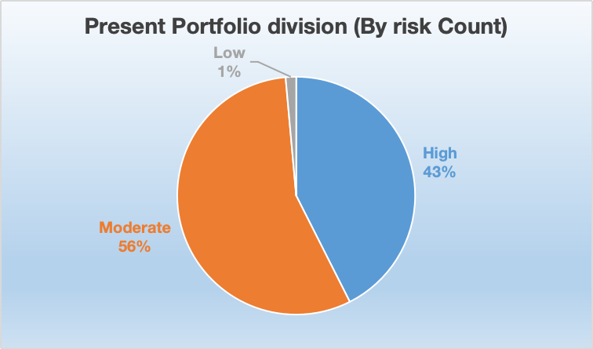
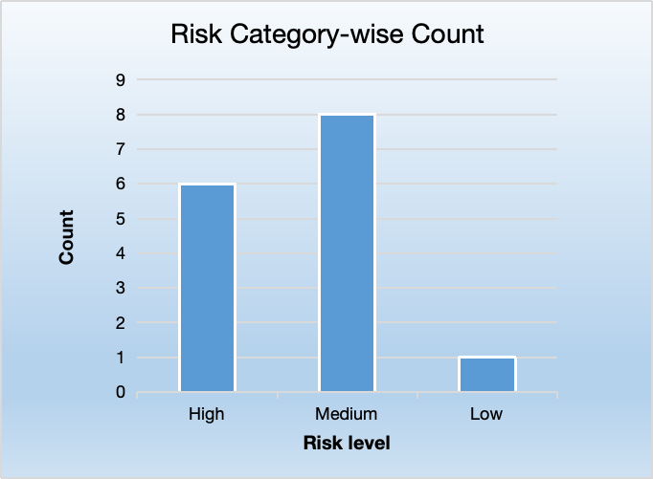
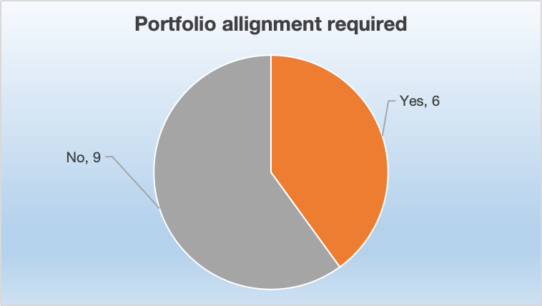
Findings- Risk assessment and categorization of clients
Current portfolio status
Risk assessment survey
Portfolio alignment
Current portfolio division after risk categorization
Results and analysis from risk assessment survey (15 responses)
After risk assessment of 15 clients it is revealed
43% of clients invested in high risk category
56% invested in moderate risk category
Only 1% chooses low risk category
Out of 15, 8 chooses Medium risk category
6 chooses High risk investment
6 clients needs realignment of their portfolio
A BDM Capstone Project
IITM BS Degree Program
Notes:
After risk assessment and categorization of the clients is is found that
Actual client portfolios that the business currently manages consist of
43% are of high-risk categories,
56% in moderate, and
only 1% in low-risk funds.
After the risk assessment, we received responses from 15 clients and found that:
Out of 15, 8 of clients prefer medium-risk investments, while,
Although 6 favor high risk.
Out of fifteen, six clients were identified with portfolios misaligned with their risk tolerance and need rebalancing

Slide 8
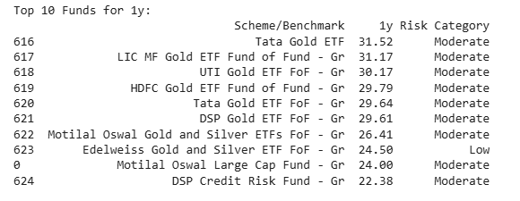
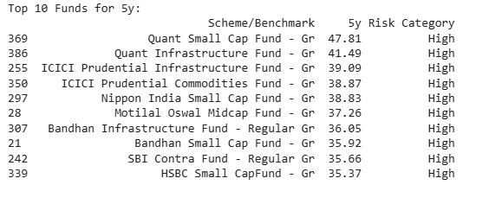
Findings- Top performing funds - Riskwise
Top 10 performing funds - 1 year
Top 10 performing funds - 5 years
Mostly Moderate risk category
Metal based funds
Average returns 27%
All high risk funds
Mostly small cap funds
Average returns 38%
A BDM Capstone Project
IITM BS Degree Program
Notes:
Over the past one years, the top 10 performing funds were
mostly with moderate-risk,
mainly metal based funds and
returns 27%
But the top 10 performing funds over the past five years, were
all in high-risk,
mainly small-cap categories,
delivering an average return of 38%.

Slide 9
Recommendation
1
Conduct regular campaigns -
Campaigns at different helps significantly in funds inflows.
3
Do risk assessment during new investments for new clients and and follow up with existing clients to ensure accurate investment guidance.
2
Track high-value investors closely to manage redemption risk.
4
Suggest low-risk funds for short-term needs, high-risk funds for long-term growth, and moderate-risk funds for medium-term goals to give clients a good balance of safety and returns
A BDM Capstone Project
IITM BS Degree Program
Notes:
After the analysis recommendation that I had provided to the business are:
Regular, targeted campaigns should be held to increase new investments, repeating prior successes.
High-value clients should be tracked closely to manage redemption risks and maintain AUM stability.
Mandate risk assessment for all new clients and regularly update existing client assessments to keep portfolios properly aligned.
Suggest low-risk funds for short-term needs, moderate-risk for medium-term, and high-risk for long-term goals.

Slide 10
Thank you
With special thanks to Mr. Indrajit Mondal, owner of Unique Enterprise, for his kind support.
Debjit Mondal | 23f2004618 | BDM Capstone Project
23f2004618@ds.study.iitm.ac.in
IITM BS Degree Program
A BDM Capstone Project
IITM BS Degree Program
Notes:
That's all from my side
Special gratitude to Mr. Indrajit, owner of Unique Enterprise, for his support during this project.
Thank you for your attention.

